Slide 1
Topic 11 – Neural Nets, Deep Learning, and AI
Data Science for Business
Prof: Chris Volinsky
NYU Stern: Fall 2024

Slide 2
Deep Learning - Intro
We learned the basics of neural nets in an earlier chapter
Biological inspirations
Black box models for regression and classification
NN explosion since the early 2000s
Moore’s law (computation and storage getting cheaper)
Funded research (Google Brain, MSFT, Facebook FAIR)
It is an incredibly complex and deeply technical field with a lot still to be figured out
Neural nets => Deep Learning => (Gen)AI => AGI(?!??)
ISL – Chap 10

Slide 3
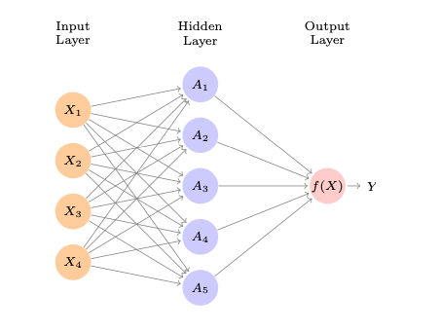
Neural Nets: Single Layer Network
Input Layer: features
Input layer is typically fully connected to a hidden layer using weights that define a linear combination
Nodes in hidden layer apply an activation function
A linear combination of the outputs of the hidden layer get sent to the output layer
Output layer gets transformed (perhaps via threshold)to a prediction

Slide 4
Neural Nets: Single Layer Network
User sets the architecture:
How many nodes? What is the activation function?
The weights are all fit from training data
Uses technique called back-propogation – which iteratively fixes error, given a loss function
NN are another example of ensemble models

Slide 5
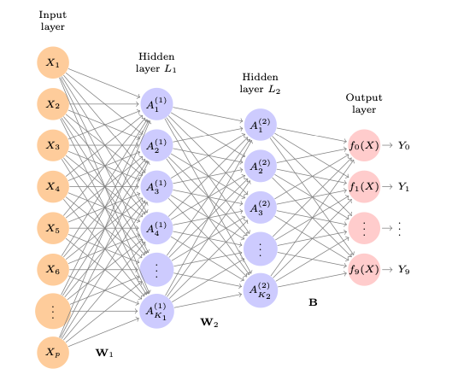
Neural Nets – Deep Learning
Neural nets with multiple hidden layers are referred to as deep.
Often the output layer has multiple classes (like images)
So many parameters!
only feasible within the last 15 years or so
This is a deep learner used to predict handwritten digits
ISL p404
p = 28 x 28 = 784
Hidden layers have 256 and 128 nodes
Total of 235,146 parameters to fit
😱

Slide 6
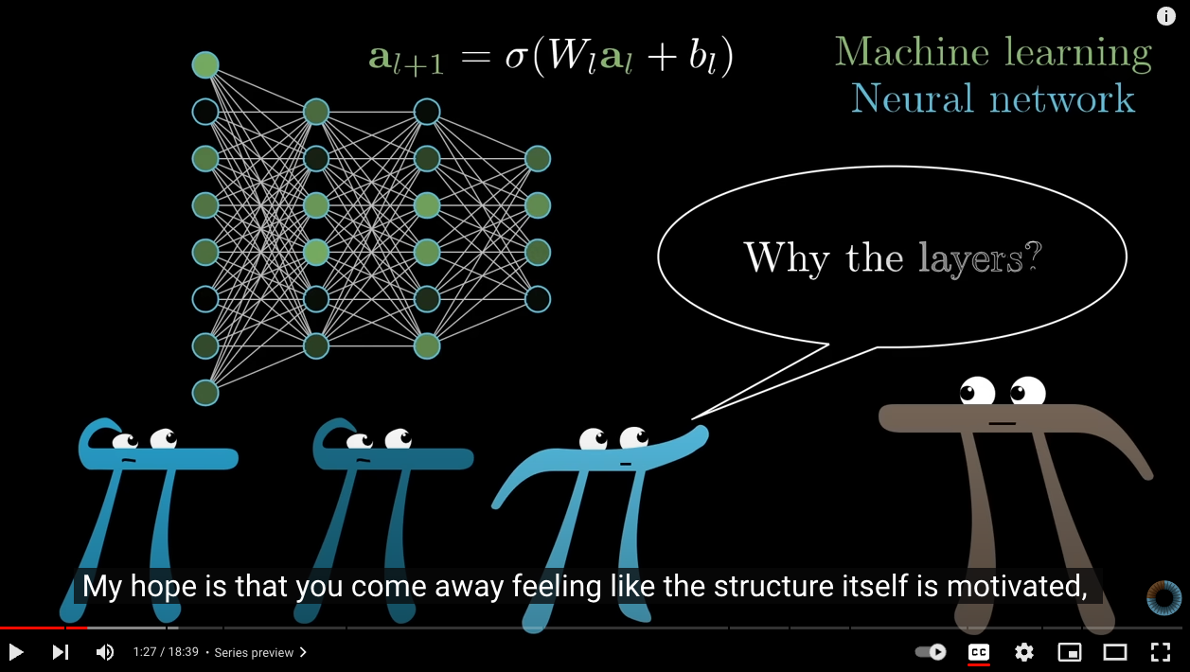
Excellent description of NN
3 Blue 1 Brown YouTube video
But What is a Neural Network??
02:45 => 13:24

Slide 7
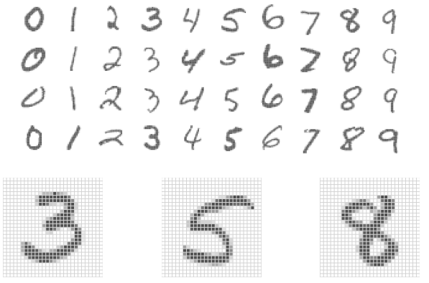
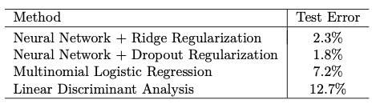
MNIST data
Handwritten digits
28 x 28 matrix of pixels
Each pixel has a value in (0,255)
60k training images
10k test images
Data freely available
Using architecture on previous page:
Notes:
8 bit encoding

Slide 8
Extensions of Neural Nets

Slide 9
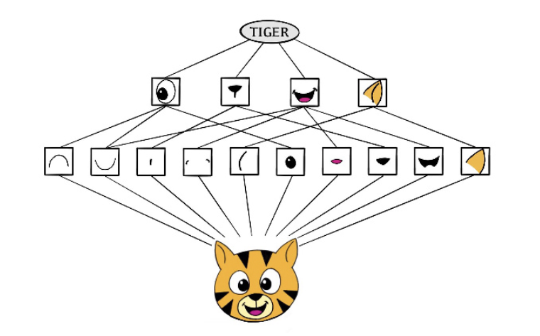
Convolutional Neural Nets (CNN)
Neural Net specifically built for media, images, etc
Special layers called convolutional layers focus on detecting patterns such as edges, shapes and textures
Preserves spatial relationships (rather than just looking at each pixel separately
Motivated by how humans detect things
Higher level features: eyes, ears, shapes
Low level features: color, edges, textures

Slide 10
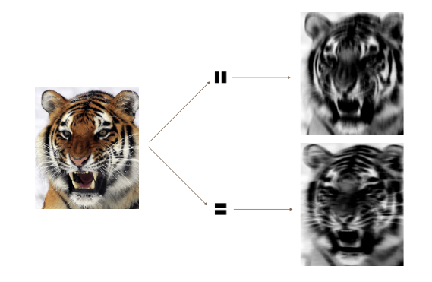
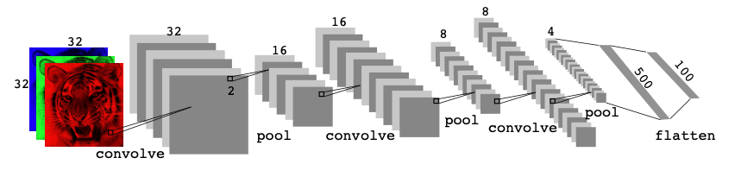
Convolutional Neural Nets (CNN)
Convolving allows you to look for specific patterns:
CNN architectures are very complicated!

Slide 11
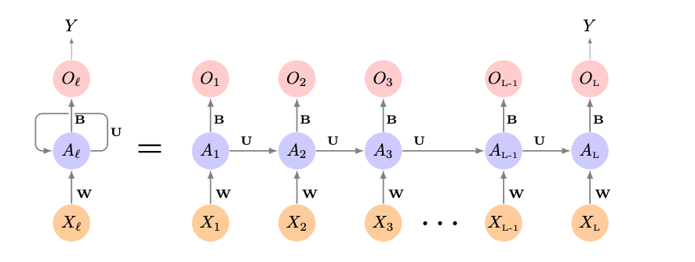
Recurrent Neural Networks (RNN)
Specifically built to handle data where order and context matter
Think words, speech, text
Time Series
RNNs take ordering into account
Keep information from previous inputs and use it to process following inputs
Architecture is sequential and has memory
Processed one vector at a time…
Notes:
LSTMS are able to keep “context” from earlier in the document while parsing local context from most recent context.

Slide 12
Long Short-Term Memory (LSTM)
One version of RNNs combines long-term and a short-term memory
Will “retain” important info from the beginning and combine with local info
This is called a Long Short-term Memory (LSTM) model – a very popular and powerful version of RNN
Shown to be incredibly versatile and useful
Text, time-series, speech recognition , music composition…
Notes:
Stock prediction, music compoosition

Slide 13
Deep Learning – Useful Tools
Tensorflow
Open source flexible library for building DL systems
Low level language creates a steep learning curve
Keras
Higher level ”building blocks” interface to TF (and other tools) makes it good for beginners
Cant build deeper more complex architectures
PyTorch
Uses “dynamic computation graph”
Built for integration into Python
Has a large user community and
MXNet, FastAI, DL4J – it is a rapidly changing field ..

Slide 14
Deep Learning - summary
Not always the best model…often overkill for simple problems!
Could take a lifetime to master these!
Fertile field, constantly changing
Architectures are hard to get right
ISL book has great descriptions of deep learning in Chapter 10
Including code and examples for
CNN
RNN
Time series predictions

Slide 15
Deep Learning into Generative AI
Another powerful model was developed by researchers at Google in 2017
Attention is All You Need by Vaswani, et al
Introduced Transformers
Transformers are complicated NN archicectures
Including millions or billions of parameters
Evaluates a whole page of text at once, not just one word at a time
Considers how each word relates to all other words in the sentence and page
Described a new architecture for deep learners
Learns patterns of language (e.g. adjectives come before nouns)
Transformers did something amazing – given an input prompt it
predicts what word should come next
Ensures it has proper grammar
Can continue writing more sentences, given its output
Results in cohesive, understandable paragraphs
We don’t really know why
🤯
Notes:
These transformers did so well, and seemed to show “intelligence”
The researchers who invented them didn’t even understand
The more training data, the more intelligence they showed.
openAI was the first to release one to the public, trained on hundreds of billions of “tokens”

Slide 16
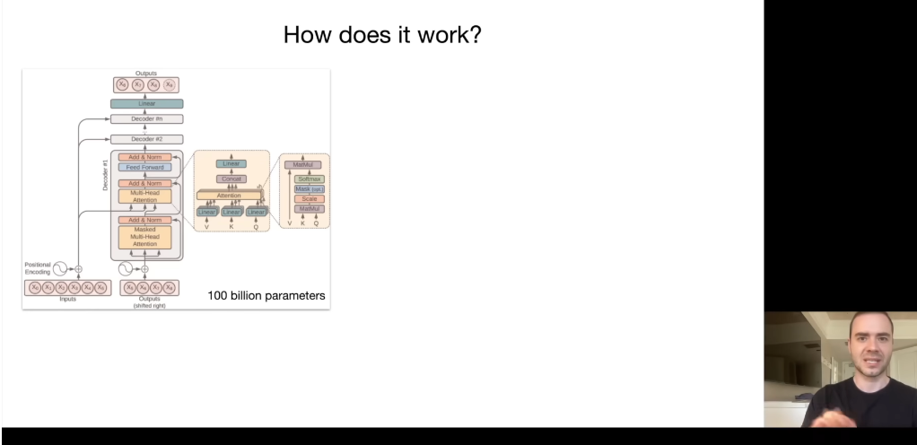
Transformers => Gen AI
Andrej Karpathy: “Intro to Large Language Models”
We don’t know how these work
Andrej Karpathy
Cofounder of OpenAI
https://youtu.be/zjkBMFhNj_g?t=699
Notes:
13:00-14:00 range

Slide 17

Image Generation
Other models focus on image generation
General Adversarial Networks
Two “users” : generator and evaluator
Generator generates a picture and the evaluator gives feedback
Repeat until evaluator cannot tell the difference between real and fake
Other models include
Variational Autoencoders (VAE)
Diffusion Models
generate a picture of a data science class in a business school, enjoying their last lecture from their charismatic professor

Slide 18
thank you.

